Slide 1



Investor Presentation

Slide 2
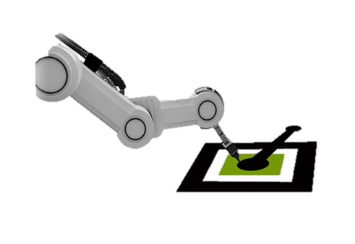
Overview
Smart Rx Systems, Inc. established in 2017 is seeking $10 million of equity to grow its robotic technology business, redefining today’s pharmacy, enabling customers to access pharmacy services at the point of care. The Kiosk will be located at physician offices, clinics, urgent care facilities, hospitals, medical office buildings, and convenient retail locations where customers can fill prescriptions quickly and easily with the ability to speak to a live pharmacist.
Rollout Strategy: The company plans to initially establish two parent pharmacies and sixteen micro pharmacies that are projected to generate positive cash flows by month twenty-three with ~$6 million in EBITDA for year 3 (Note: financial and other information is available to investors upon request. There is no guarantee that the company will be able to achieve these results)
Proven Model: The business plan and rollout is based on the company’s proven business model established in 2017 with pharmacies operating in several locations, generating approximately $8 million during the beta testing period ($1.7MM in 2019 and $3.3MM in 2020 alone)
Competitive Advantage: Performs all functions of finding, counting, labeling without any contamination and digital pharmacist verification. Fulfills these functions on demand more efficiently than a traditional retail pharmacy, and improves patient convenience by dispensing medication at the point of care
Cost Savings: As per management analysis, each combination of a parent pharmacy and 7 micro pharmacies accounts for operational savings as a result of lower space requirement and reduced operating costs of personnel and inventory
Management: Over 25 years of experience leading turnarounds and driving growth for global start-up to Fortune 500 technology and business service organization

Slide 3


Key Investment Highlights
Proven Model: The Kiosk has been operational in several locations - the technology works, is compliant, and saves time and money
Pharmacy of the Future: Disruptive technology that is entirely automated delivering a new robotic system at the point of care with higher accuracy, lower startup and operating cost
Strategic Partnership: Partnered with a global automated pharmacy robotics manufacturer that provides 24/7 installations and maintenance with the capability to manufacture 40 kiosks monthly
Locations: Previously six locations in Texas and Florida

Slide 4

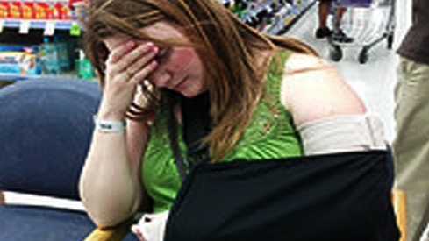
The Problem
Current pharmacies (brick and mortar businesses) have high startup and fixed costs
Inconvenient to patients
Manual counting and manual verification that can result in significant errors
Unnecessary waiting time by sick patients
4

Slide 5
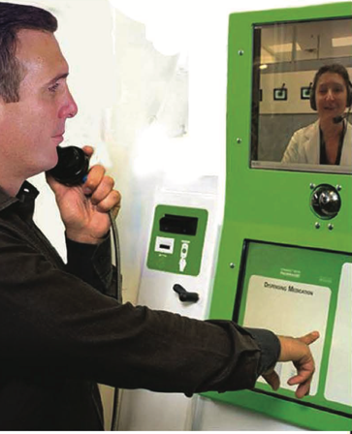
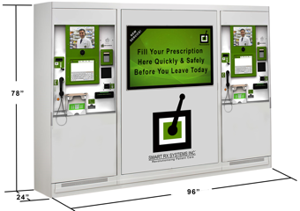
The Solution
Space: Total operational footprint is just 150-250 SF, as opposed to a modern pharmacy that may require 1,700 square feet
Location: Smart PharmAssist™ Kiosks are located at the point of care and retail locations
No Long Waits: No long waits with medications dispensed in one minute or less
Accuracy: Management confirms that the product has a proven 99.8% accuracy rate (compared to 98.5% in a community setting according to BMJ Open Quality 2018 report)
Automated Pharmacy: provides more time for Counseling

Slide 6
The Product
Core Technology
Key Features
Networked, Internet-ready Software Platform
Custom Multi-touch Screen User Interface
Real-time Remote Monitoring
Real-time Remote Inventory Control
B2B Integration Capability
Real-time Reporting
Real-time Video Conferencing
POS Software
Custom-branded Interface Advertising
Flexible Base and Promotional Pricing
Cross-sell and Up-sell Capability
Top Insurance and Health Care Provider Partnerships
Hardware
LCD Touch-screen Interface
Credit Card Reader
Biometric Reader
Image Capturing Technology
Real-time Video Conferencing
Paper and Electronic Receipt Printer
Document Scanner
Facial Recognition Technology
Technology
Integration Capabilities
Real-time Pricing Feed
Real-time Sales Data
Real-time Inventory Control
Reporting
Real-time Connectivity
Sales and Inventory Analysis
Impressions Data Analysis
Consumer Survey Data
https://www.smartrxsystems.com/media

Slide 7

The Opportunity
Demand:
The pharmacy market is expected to grow at a CAGR of 6.3% to $861 billion by 2028
1
Motivated Operators:
Additional revenue streams to physicians and retailers
2
Way to Attract and Retain Patients
In the age of consumer driven healthcare, provides a competitive edge for operators to attract and retain customers
3

Slide 8
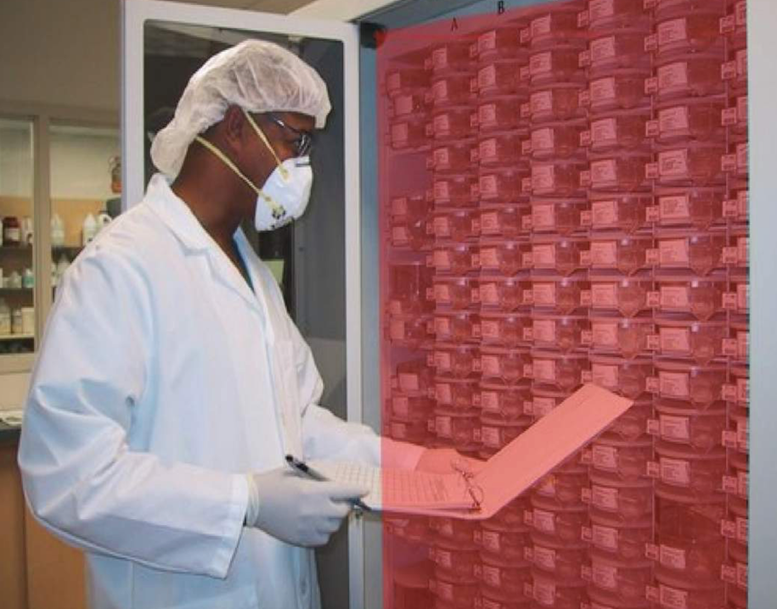
Security Measures
Management confirms:
The Smart PharmAssist™ Kiosk has multiple security cameras to monitor all activities
The cameras record all medication fillings by the robotic arm
Recording of all employee access to medication cartridges
Dual verification of medication
Software can identify each tablet by color, shape, size and markings which allows faster Pharmacist verification leaving more time for counseling

Slide 9
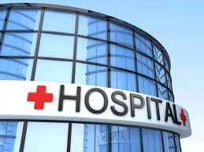
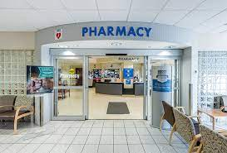
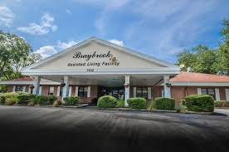

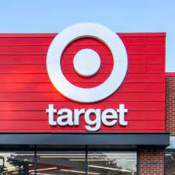
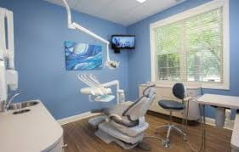
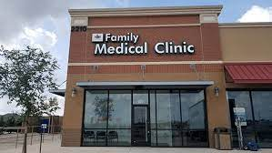
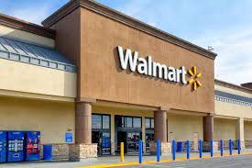
Target Market
Assisted and Senior Living
Hospitals
Retail Pharmacies
Urgent Care
Retail Stores
Dental Clinic
Point of Care

Slide 10

Growth Strategy
More Pharmacies at a Lower Cost: Install up to seven micro pharmacies for each parent pharmacy. Management confirms that micro pharmacies can be opened for about 30% to 40% of the cost and has lower operating cost compared to a parent pharmacy
Short-Term Growth: Implement 2 parent pharmacies and 16 micro pharmacies within the first two years. Company is expected to be cash positive by month 23 of operations
Long-Term Growth: Ramp up to 1,000 locations, domestically and internationally with the ability to customize compounds as prescribed by physicians
E-commerce: Establish a website to sell minor related durable goods and over the counter medicines to increase revenues and increase customer base
Virtual Consulting: Develop a virtual counseling center to augment the planned new mobile application

Slide 11
Competitive Differentiation
While all pharmacies are competitors, management is confident that currently no other pharmacies are automated robotic medication fulfilment pharmacies, offering over the counter and prescription medication at the point-of-care or retail stores.
Deliver prescriptions with a higher level of accuracy compared to the rate of errors at traditional pharmacies
Fulfill prescriptions in less time for patients with existing records with no patient travel to another location at no additional cost
Access Pharmacy services at the point of care and retail locations
Occupies a very small space (150-250 SF), which vastly reduces start-up costs compared to traditional pharmacies
Reduces personnel costs as the dispensing, verification, labelling, and medication literature is all done by the Kiosk - better utilization of pharmacist’s resources, focusing on medication therapy instead of counting pills
11

Slide 12
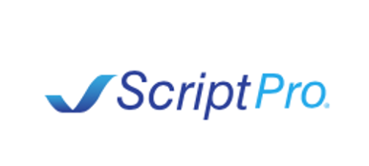
Partnerships
Partnership with ScriptPro, one of the largest robotic kiosk manufacturers providing manufacturing, installation and 24/7 maintenance
Founded in 1994 with its corporate headquarters in the Kansas City area
ScriptPro is Experienced in robotics manufacturing, pharmaceutical inventory control and dispensing
The company’s initial product, the SP 200 Robotic Prescription Dispensing System, pioneered the use of robotics in community pharmacies
ScriptPro offers a comprehensive line of over 200 pharmacy automation and management system products that have revolutionized pharmacy operations in the U.S. and around the world
12

Slide 13

Management
Santu Rohatgi: Co-Founder, Chairman, President and CFO
Senior strategy, finance, operations, and business transformation executive with over twenty-five years of experience leading turnarounds and driving growth for global start-up to Fortune 500 technology and business service organizations. Experience in managing multi-functional teams and large-scale projects, supporting mergers and acquisitions, and presenting objective strategic recommendations to stakeholders and investors. Expertise includes financial and strategic planning, accounting, capital raising, and general administrator. Deep knowledge in reporting, operational improvements, contract negotiations, due diligence, cost reductions, project management, Virtual Cloud and ERP system implementations. Held various management positions at NCR, AT&T, Universal Credit Card, Fore Front, and Ceelox. Schools include Eastern New Mexico University, Wright State University, George Washington University, Harvard Business School Online, and Wharton Business School Online. Education includes MA, MBA, CPA, CM&AA.

Slide 14
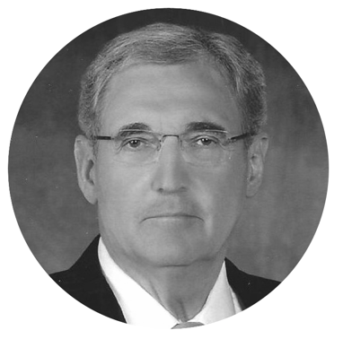
Board of Directors
David R. VanValkenburg
Experienced corporate executive and seasoned member of corporations’ boards of directors. corporate experience includes four years as an Investment Analyst, ten years in general management, sixteen years as a President of private and public companies, and over twenty years as a member of twenty-two public and private corporate boards of directors.

Slide 15

Board of Directors
Roman Rohatgi
Executive with 20 years of corporate experience across several industries and organizations, ranging in size from startups to multi-billion dollar entities. Experience covers broad commercial strategy, pricing, contract negotiations, and corporate finance with focus on business modeling and profitability improvement.

Slide 16
Sources and Uses of Funds
Sources |  | Uses
Capital Raised | $10,000,000 | Pharmacy with Compounding (Licenses) | $500,000
 |  | Pharmacy (License) | $350,000
 |  | 16 Micro-Pharmacies (LLC) | $32,000
 |  | Capital Requirement Pharmacies | $1,000,000
 |  | Capital Requirement Micro Pharmacies | $4,000,000
 |  | Start-Up and Infrastructure costs | $713,000
 |  | E-Commerce Build & Inventory | $300,000
 |  | Operations (Vendors Pre-paid+ Contracts) | $200,000
 |  | Inventory + IT + Accounting + Other Operating Expenses | $2,155,000
 |  | Transaction Expenses/Fees | $750,000
Total | $10,000,000 | Total | $10,000,000

Slide 17
General Risks
Financial models and other supporting information information regarding historical data, hypothetical target returns, contextual analysis, and other pertinent matters will be made available to prospective investors upon request. There is no guarantee of success, and there is a potential for loss of your investment
Risks related to market conditions and governmental program
  We may be adversely impacted by weakness in the local economies we serve
  New legislation and/or regulatory laws affecting our operations may affect our performance
Risk related to our business/operations
  We may be unable to successfully execute and manage our growth strategy
  Our success will depend on our ability to hire, train and retain key personnel
  Risks related to proposed financial transaction
  The industries in which we operate are highly competitive and many of our competitors have access to greater financial resources, lower funding costs and greater access to liquidity
  Unfavorable future conditions could adversely impact our business, financial position, results of operations and/or cash flows
Risks related to funding sources and interest rates/debt markets
  We are substantially dependent upon our secured and unsecured funding arrangements. If any of our funding arrangements are terminated, not renewed or otherwise become unavailable to us, we may be unable to find replacement financing on economically viable terms, if at all, which would have a material adverse effect on our business, financial position, results of operations and cash flows
  Changes in economic and legal conditions could materially and adversely affect our transactions, business, financial position, results of operations or cash flows
  Our earnings and reputation may be adversely affected if risk is not properly managed
Risks related to proposed financial transaction
  There is no assurance that we will be able to obtain additional capital as needed
  There is no guarantee of success, and there is a potential for loss of your investment
  There can be no assurance that any financial projections delivered to a prospective investor will accurately reflect the predicted profitability of our business
  There is currently no market for our securities; and it is unlikely that a market will develop in the future, which would impact your ability to resell our securities in an orderly fashion

Slide 18
Specific Risks
Limited operating history (approximately eight years), and in commercial βeta and limited non-βeta operations for approximately four years
There is no assurance that the company will be able to successfully achieve its profit objectives
Company has not generated significant revenues yet
Company’s assumptions of development are based on its current status of sources of revenues and business, which is no guarantee for generation of revenues in the future
The company may not be able to successfully operate additional acquisitions and integrate related investments into its business, which could adversely affect its investment returns materially
The company depends on a manufacturer exclusively to provide them the Kiosks, hence disruption of supply could adversely affect the business
Offering price may not accurately represent the current value of the company or assets at any particular time, therefore, the offering price may not be supported by the value of assets at the time of purchase
Board and management have broad discretion on managing the company and taking corporate actions for the benefit of the business, which may subject the shareholders to adverse impact
An investment in in the offered shares is a speculative investment, therefore no assurance can be given that investors will realize their investment objectives
A prospective shareholder could lose all or a substantial portion of its investment
No public market exists for the either shares of common stock or preferred stock, adversely impacting liquidity

Slide 19


Company
INDUSTRY
Healthcare
INVESTMENT TYPE
Equity
LOCATION
Florida
COMPANY TYPE
Digital Health
SIZE
$10 M

